Slide 1
Abstractive News Summarization for Bangla Documents Using LSTM Network Model
Presented By -
Md.Shajib Hossain (19101250)
Md. Muhimenul Mubin
Mehnaz Ara Fazal, ST
Sania Azhmee Bhuiyan, RA

Slide 2
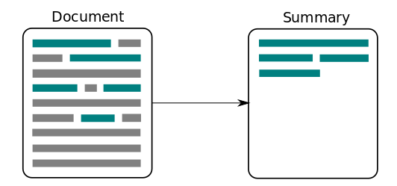
Introduction
2 types of summarization -
Abstractive
Extractive
Novel system for abstractive summarization of Bengali news articles.
LSTM network model with attention at encoder-decoder, designed to generate human-like sentences summarizing Bengali news documents
demonstrating significant improvement over existing approaches

Slide 3
Motivation and Purpose
To generate a meaningful idea over a large documents and save time
to contribute to the field of abstractive summarization, particularly in languages other than English, and to provide a valuable resource for Bengali news summarization.

Slide 4
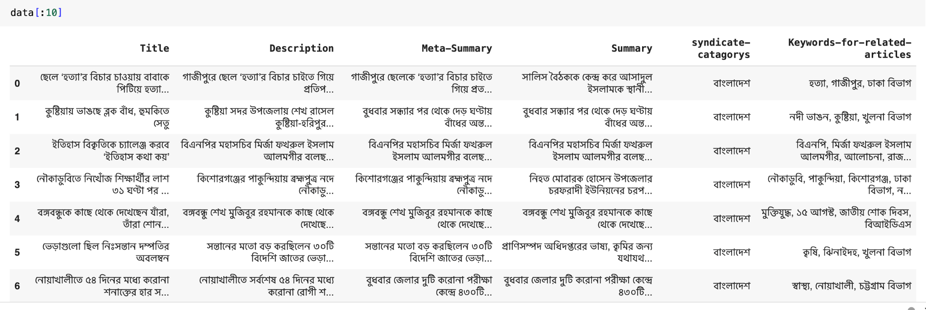
Dataset
Publicly available dataset on kaggle consisting over 19,000 Bengali news articles and their corresponding human-written summaries.
The dataset has the largest number of news summarization dataset
Has both the Actual news and Human-written summaries.

Slide 5
Methodology
Data Collection
Our Collected data has over 19,000 news articles along with its summaries
For our work we have worked only on 2 columns of the dataset (Description and Summary)
Had 6 different columns for each instances

Slide 6
Methodology
Data Pre-processing and Cleaning
Removed unwanted columns.
Removed all the Bangla Stop words.
Also removed special characters like (~ , / , ! , * , + , &, ©, ø, "').
Added start at the beginning and stop at the end of every summary.

Slide 7
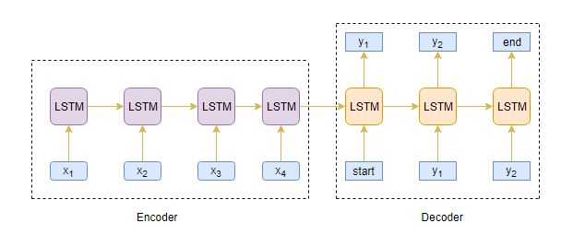
Model Description LSTM
STM stands for Long-Short Term Memory. LSTM is a type of recurrent neural network but is better than traditional recurrent neural networks in terms of memory.
Uses seq2sqe model
Encoder and Decoder component is used

Slide 8
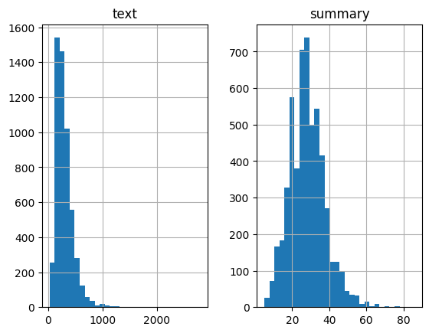
Methodology
Training our proposed Model
Selecting a Threshold regarding how many words will our summary have.
Splitted the data as training set gets 90% and Test set get 10%

Slide 9
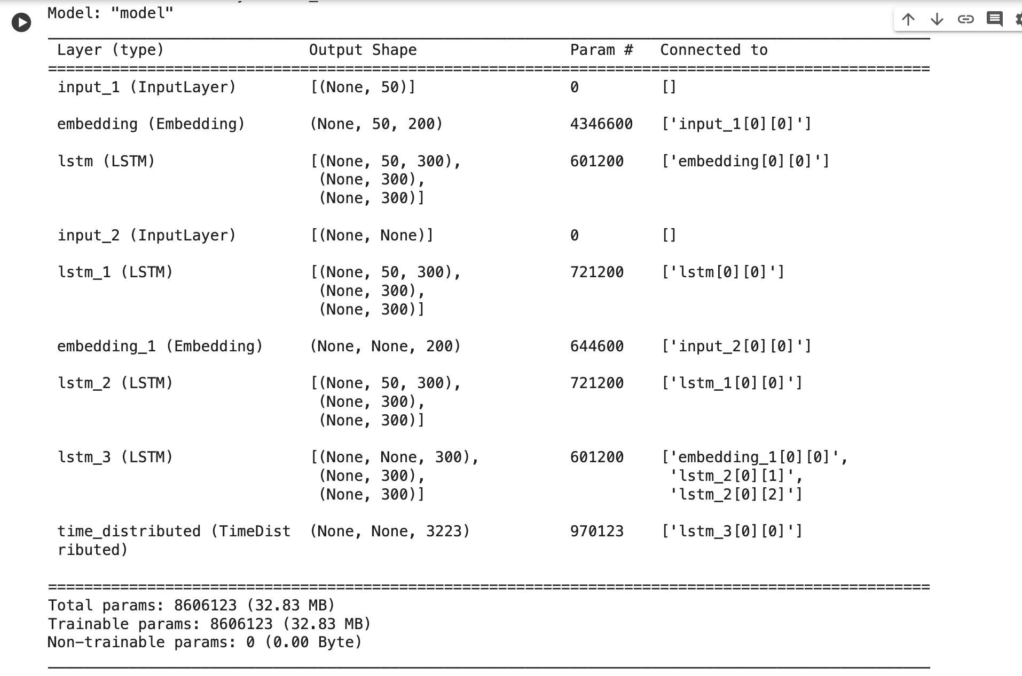
Methodology
Training our proposed Model
For our Proposed model we have used 3 stacked LSTM model for better representation
Firstly we have embedded our tokens.
Then 3 LSTM encoder has been created using tensorflow & keras
Again in the same fashion decoder LSTM and lastly added the dense layer
20 epoch with batch size of 144 has been used while fitting

Slide 10
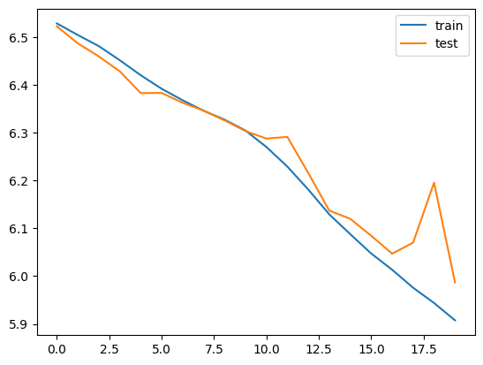
Results and analysis
Figure 3: Training and Validation Loss curve

Slide 11
Limitations And Future Work
LSTMs are computationally more intensive compared to other neural network architectures
Training LSTMs can be slower and may require more resources.
Future Work
Enrich the dataset more with recent news in Bengali
Configure our models configuration to get the desired outputs
Proposed model needs to be improved

Slide 12
The END

